Slide 1
PCA three ways:
SVD, Eigendecomposition
& a Linear Autoencoder
MA30241 · COMPUTATIONAL LINEAR ALGEBRA · COURSE PROJECT PRESENTATION
Do all three find the same principal subspace, and at what cost?
GROUP MEMBERS
Ponna Sai Nithish
Sarvesh Mahajan
Sidhant Mishra
Shaurya Pratap
24MA10052
24MA10060
24MA10064
24MA10061
10 November 2026
Notes:
Opening (about 1 minute). We are presenting our MA30241 project: three ways to compute Principal Component Analysis. Two are classical linear algebra (SVD of the data, eigendecomposition of the covariance) and one is a neural network (a linear autoencoder). One colour per method is used on every slide: teal = SVD, orange = eigendecomposition, violet = autoencoder.

Slide 2
Three ways to compute principal components
PROBLEM STATEMENT
Given a centred data matrix X (N samples × d features), PCA finds the k orthonormal directions that keep the most variance. We compute them three ways and ask: do they agree, and what does each cost?
Method 1 · classical
Method 2 · classical
Method 3 · neural network
SVD
Eigendecomposition
Linear autoencoder
Factor the data directly: X = UΣVᵀ. The directions are the columns of V.
Form the covariance C = XᵀX/(N−1) and diagonalise it: C = QΛQᵀ. The directions are its top eigenvectors.
Train a network x → z → x̂ with a k-unit bottleneck to copy its input. It learns the same subspace.
WE COMPARE
Complexity
Execution time
Memory
Reconstruction error
Subspace match
Scalability in d
MA30241 · PCA three ways
2 / 10
Notes:
Problem statement (about 1 minute). PCA looks for the k directions along which the data varies most. Linear algebra gives two direct routes: the SVD of the data matrix, or the eigenvectors of the covariance matrix. A neural network gives a third, learned route: an autoencoder that squeezes each sample through k hidden units and tries to rebuild it. Our only goal is to compare these three on complexity, time, memory, reconstruction error, how close the autoencoder gets to the true principal subspace, and how each scales with the number of features d.

Slide 3
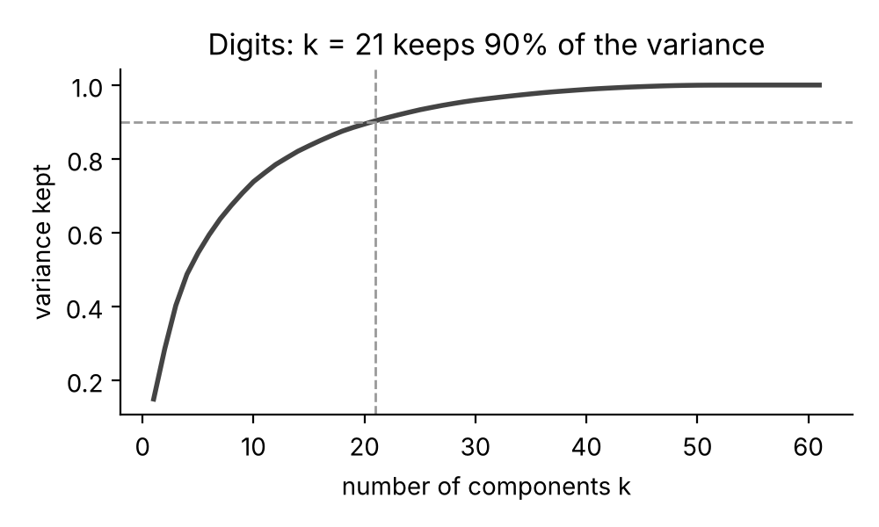
PCA is a best low-rank approximation
BACKGROUND · FROM THE CLASS NOTES
1. SVD = a sum of rank-1 pieces
X = UΣVᵀ = σ₁u₁v₁ᵀ + σ₂u₂v₂ᵀ + … + σᵣuᵣvᵣᵀ
X is centred (column means removed); σ₁ ≥ σ₂ ≥ … ≥ σᵣ > 0
2. Most variance = Rayleigh quotient
max over v ≠ 0 of vᵀXᵀXv / vᵀv = σ₁², at v = v₁
then v₂ ⟂ v₁, …: principal directions = right singular vectors
3. Eckart–Young: the truncated SVD is the best rank-k fit
Xₖ = σ₁u₁v₁ᵀ + … + σₖuₖvₖᵀ
Frobenius error ‖X − Xₖ‖ = √(σ²ₖ₊₁ + … + σ²ᵣ), the smallest possible
Digits data: share of the total variance kept by the first k components.
4. Choosing k: keep 90% of the energy
(σ₁² + … + σₖ²) / (σ₁² + … + σᵣ²) ≥ 0.90
smallest such k; for our digits data this gives k = 21
MA30241 · PCA three ways
3 / 10
Notes:
Background (about 1.5 minutes). Four facts from our class notes are all we need. (1) The SVD writes the centred data as a sum of rank-1 matrices ordered by singular value. (2) The direction of maximum variance maximises the Rayleigh quotient vᵀXᵀXv / vᵀv; the maximum is σ₁² at v₁, and the next directions are found orthogonal to the previous ones. (3) Eckart–Young: keeping the first k terms gives the best rank-k approximation, so PCA reconstruction is a low-rank approximation problem and we know the smallest possible error. (4) We pick k as the smallest number of components that keep 90% of the energy: k = 21 for the digits (the plot on the right).

Slide 4
SVD of X vs eigendecomposition of XᵀX
METHODS 1 & 2
1 · SVD
2 · Eigendecomposition
X = U Σ Vᵀ
C = XᵀX / (N − 1) = Q Λ Qᵀ
Directions
first k columns of V
Directions
top k eigenvectors (columns of Q)
Cost
O(Nd²) for N ≥ d
Cost
O(Nd²) to form C + O(d³) for eigh
Memory
O(Nd + d²): keeps the N × d factor U
Memory
O(d²): only the d × d matrix C
NumPy
np.linalg.svd(X, full_matrices=False)
NumPy
np.linalg.eigh(C)
Why they agree
The catch: κ(XᵀX) = κ(X)²
XᵀX = VΣ²Vᵀ, so Q = V and λᵢ = σᵢ²/(N − 1). On the digits data they match to 3 × 10⁻¹⁵.
Läuchli test, ε = 10⁻⁸: SVD finds σ₂ = σ₃ = 10⁻⁸ exactly; eig of XᵀX gives 0, since 1 + ε² rounds to 1.
MA30241 · PCA three ways
4 / 10
Notes:
Methods 1 and 2 (about 2 minutes). SVD works on the N × d data matrix itself; the principal directions are the first k right singular vectors. The eigendecomposition route first forms the small d × d covariance matrix C = XᵀX/(N−1) and then uses a symmetric eigensolver. They agree because XᵀX = VΣ²Vᵀ: the eigenvectors are the right singular vectors and λᵢ = σᵢ²/(N−1); on the digits the variances match to 3 × 10⁻¹⁵. Both cost O(Nd²) when N ≥ d, but eig only stores a d × d matrix while SVD also builds the N × d factor U. The catch: forming XᵀX squares the condition number. In the Läuchli matrix [[1,1,1],[ε,0,0],[0,ε,0],[0,0,ε]] with ε = 10⁻⁸, 1 + ε² equals 1 in double precision, so XᵀX becomes the all-ones matrix of rank 1 and the two small singular values are lost (computed eigenvalues are about −6 × 10⁻¹⁶ and −2 × 10⁻¹⁷, i.e. zero). SVD recovers them exactly.

Slide 5

A linear autoencoder learns the PCA subspace
METHOD 3
BOURLARD & KAMP (1988)
x
W₁
z
W₂
x̂
Minimising E is a best rank-k approximation problem, so the optimum comes from the SVD:
input, ℝᵈ
ℝᵏ, k < d
output, ℝᵈ
W₂ = Vₖ T⁻¹, W₁ = T Vₖᵀ
encoder
decoder
for any invertible k × k matrix T
W₂W₁ = VₖVₖᵀ: projects onto the PCA subspace
basis is not orthonormal, not ordered
sigmoid hidden units do not help
Loss: total squared reconstruction error (no activation, no biases)
E = Σₙ ‖W₂W₁xₙ − xₙ‖²
Trained by back-propagation with Adam: mini-batches of 32, 100 epochs, learning rate 0.05 → 0.0003. Biases are not needed because the data is centred.
Cost O(E·Ndk) for E epochs · memory O(dk) + one mini-batch
MA30241 · PCA three ways
5 / 10
Notes:
Method 3 (about 2 minutes). The autoencoder is a two-layer network: the encoder W₁ maps a d-dimensional sample to k hidden numbers, the decoder W₂ maps them back to d numbers, and training minimises the squared reconstruction error. With linear units, W₂W₁ is a matrix of rank at most k, so this is exactly the best rank-k approximation problem from the previous slide. Bourlard and Kamp (1988; IDIAP reprint 2000) show the optimal weights are W₂ = VₖT⁻¹ and W₁ = TVₖᵀ for any invertible T, so W₂W₁ = VₖVₖᵀ is the orthogonal projection onto the principal subspace. Because T is arbitrary, the learned vectors span the right subspace but are not orthonormal and not sorted by variance (Bishop, Deep Learning, section 19.1.1). The paper also shows that sigmoid hidden units do not improve on this. The output bias only reproduces the mean, so we centre the data and drop biases. We train with mini-batch Adam: cost O(Ndk) per epoch, and memory is just the weights plus one batch.

Slide 6

Two datasets, five measurements
EXPERIMENTS
WHAT WE MEASURE
Digits (real data)
Measure | How
Time | fastest of up to 5 runs (AE: 1–2), time.perf_counter
Peak memory | tracemalloc: NumPy arrays + LAPACK workspace (input not counted)
Reconstruction error | ‖X − X̂‖ / ‖X‖, compared with the Eckart–Young optimum
Subspace match | largest principal angle to the SVD subspace
Scalability | repeat for d = 50, 100, 200, 400, 800, 1600
1797 handwritten digits (0–9), each an 8 × 8 grey-scale image = 64 pixels. 3 always-blank pixels dropped → N = 1797, d = 61; k = 21 keeps 90% of the variance.
Synthetic data (scalability)
N = 2000 points in d = 50 … 1600 dimensions, built from 10 hidden factors (std 3 → 1) plus noise (std 0.1). The true subspace is 10-dimensional, so k = 10.
Same centred data for every method · NumPy 2.5 (OpenBLAS) · 2-core Intel Xeon, 2.1 GHz
6 / 10
Notes:
Experimental setup (about 1 minute). Dataset 1 is the scikit-learn digits dataset: 1797 small scanned images of handwritten digits, each 8 × 8 pixels, so every image is a vector of 64 numbers. Three pixels are blank in every image, carry no information, and are dropped, leaving d = 61. The 90% rule gives k = 21. Dataset 2 is synthetic so that we can control the dimension: 2000 points generated from 10 hidden factors plus a little noise, in 50 up to 1600 dimensions; the correct answer is therefore a 10-dimensional subspace. For each method we record wall-clock time, peak memory allocated during the call, the relative reconstruction error compared with the Eckart–Young minimum, and the largest principal angle between its subspace and the SVD subspace. Timings depend on the machine; the ratios and trends are what matter.

Slide 7
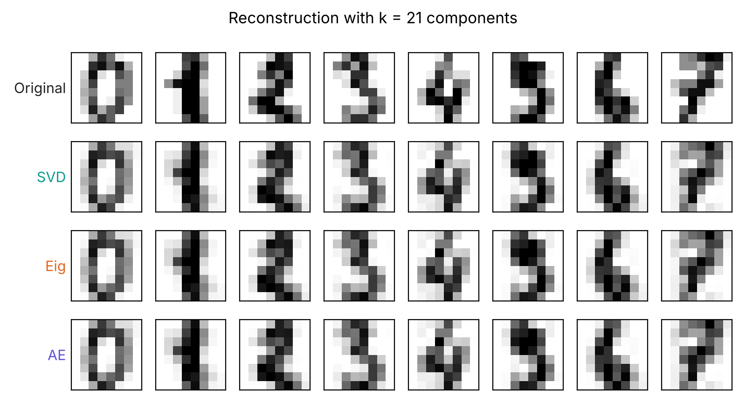
All three reach the best possible error
RESULTS · DIGITS (N = 1797, D = 61, K = 21)
Method | Time | Peak memory | Rel. error | Angle to SVD
SVD | 5.5 ms | 2.82 MB | 0.3111 | 0°
Eig | 0.85 ms | 0.16 MB | 0.3111 | ≈ 10⁻¹²°
AE | 526 ms | 0.18 MB | 0.3111 | 0.98°
Eckart–Young optimum for k = 21 is 0.311129; the autoencoder is only 0.0045% above it.
SVD and Eig agree to machine precision: variances match to 3 × 10⁻¹⁵.
Eig is about 6.5× faster than SVD; the autoencoder is about 95× slower than SVD.
Row 1: original digits. Rows 2–4: rebuilt from 21 numbers each; the three methods look identical.
MA30241 · PCA three ways
7 / 10
Notes:
Digits results (about 2 minutes). All three methods reach a relative reconstruction error of 0.3111. Eckart–Young says nothing can do better than 0.311129 with 21 components, and the autoencoder is only 0.0045% above that. SVD and eigendecomposition give the same subspace (angle about 10⁻¹² degrees) and the same variances to 3 × 10⁻¹⁵. The costs differ a lot: eig is fastest (0.85 ms) and smallest in memory, SVD takes 5.5 ms and the most memory because it also builds the 1797 × 61 matrix U, and the autoencoder needs 100 epochs of training, about half a second, roughly 95 times slower than SVD and 600 times slower than eig. Exact times change from run to run and machine to machine; the ratios are stable. The picture shows the reconstructions are visually indistinguishable.

Slide 8
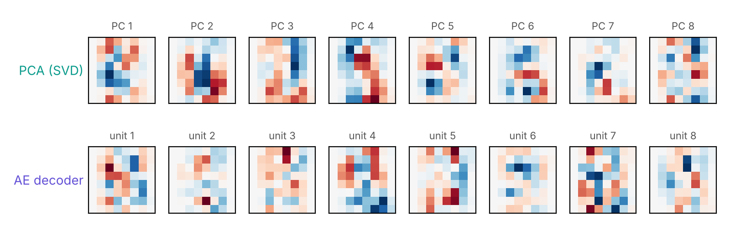
Same subspace, different basis
RESULTS · AUTOENCODER VS PCA
0.98°
largest principal angle between the autoencoder’s subspace and the PCA subspace (mean 0.23°)
0.0045%
extra reconstruction error above the Eckart–Young optimum
Top: PCA directions 1–8 (SVD). Bottom: 8 of the autoencoder’s decoder vectors. Red = positive weight, blue = negative.
5.5 – 9.2
squared lengths of the learned vectors (diagonal of W₂ᵀW₂; all 1 if orthonormal). Off-diagonals reach 1.4: not orthonormal.
Why the basis differs
Every invertible T gives the same error (W₂ = VₖT⁻¹), so training stops at some T ≠ I: each learned vector is a mix of principal components.
MA30241 · PCA three ways
8 / 10
Notes:
Autoencoder versus PCA (about 1.5 minutes). This is the key check of the theory. The largest principal angle between the subspace spanned by the autoencoder’s decoder vectors and the PCA subspace is under one degree (mean 0.23 degrees), and the reconstruction error is within 0.0045% of the optimum: the network has found the principal subspace, as Bourlard and Kamp predict. But look at the pictures: the top row shows the PCA directions in order, the bottom row the vectors the network learned. They are different, because any invertible matrix T gives the same loss. The Gram matrix W₂ᵀW₂ has diagonal entries between 5.5 and 9.2 and off-diagonal entries up to 1.4 instead of the identity, so the basis is neither orthonormal nor ordered by variance. To get the actual principal components back from the network you would still need a small k × k eigenproblem.

Slide 9
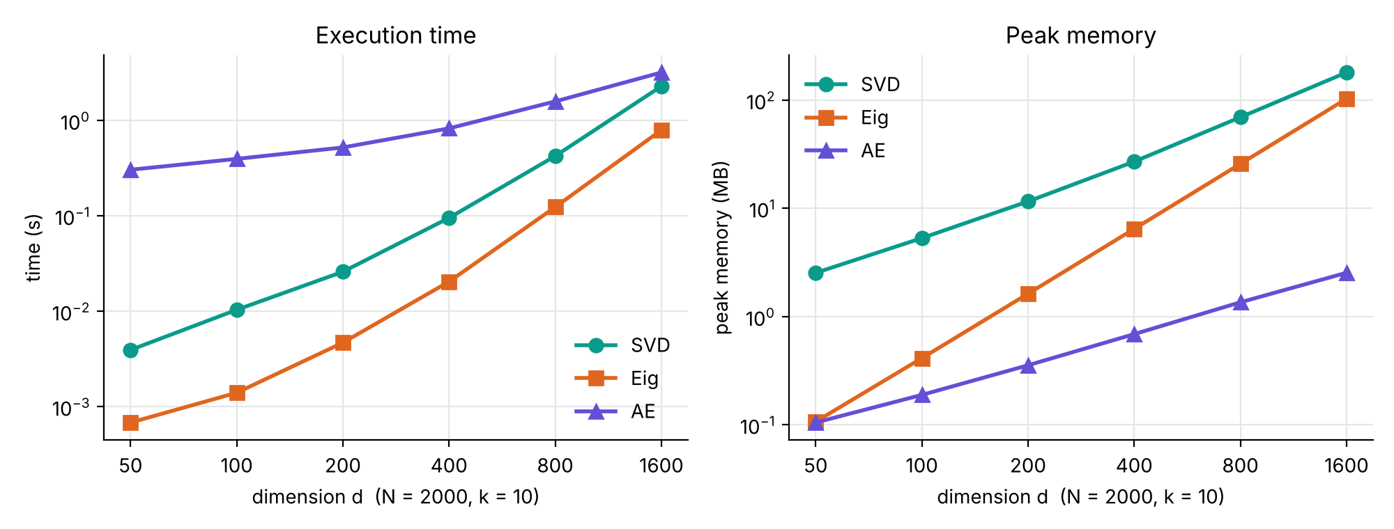
How the cost grows with the dimension d
RESULTS · SYNTHETIC DATA (N = 2000, K = 10)
AT D = 1600
Method | Time | Memory
SVD | 2.28 s | 179 MB
Eig | 0.79 s | 103 MB
AE | 3.18 s | 2.5 MB
GROWTH, D = 400 → 1600
Method | Time ∝ dᵖ | Memory ∝ dᵖ
SVD | p = 2.3 | p = 1.4
Eig | p = 2.6 | p = 2.0
AE | p = 1.0 | p = 0.9
SVD and Eig grow roughly like d², the autoencoder about linearly: its time gap to SVD shrinks from 78× (d = 50) to 1.4× (d = 1600), with 40–70× less memory. With a fixed 100 epochs its angle to the PCA subspace grows to 1.8° at d = 1600.
p above 2 for SVD and Eig: as d nears N, the d³ terms take over.
MA30241 · PCA three ways
9 / 10
Notes:
Scalability (about 2 minutes). Both axes are logarithmic, so a straight line means cost grows like a power of d, and the slope is that power. SVD and eigendecomposition grow roughly like d squared (fitted slopes 2.3 and 2.6 between d = 400 and 1600; above 2 because d is approaching N = 2000, where the d³ parts of the algorithms matter). Eig is faster than SVD at every size and uses less memory because it never builds the N × d matrix U. The autoencoder’s cost per epoch is O(Ndk), so it grows about linearly in d: it is 78 times slower than SVD at d = 50 but only 1.4 times slower at d = 1600, and it needs 40 to 70 times less memory there. The price is accuracy and tuning: with the same 100 epochs its subspace angle stays at most 0.27 degrees up to d = 800 but reaches 1.8 degrees at d = 1600, so for large d it needs more training.

Slide 10
Same answer, very different costs
CONCLUSIONS
SVD
Eigendecomposition
Linear autoencoder
Exact, orthonormal, ordered components
Most memory: stores the N × d factor U
Use for accuracy and ill-conditioned data
Same components as SVD (to 10⁻¹⁵)
Fastest in every test
Use when N ≫ d and data is well conditioned
Learns the PCA subspace (within 1°),
Basis not orthonormal or ordered; needs many epochs
Memory O(dk), time linear in d
Use for data too big for memory; leads to non-linear autoencoders
References: H. Bourlard & Y. Kamp, “Auto-association by multilayer perceptrons and singular value decomposition”, Biological Cybernetics 59 (1988) 291–294, reprinted as IDIAP-RR 00-16 (2000) · C. M. Bishop & H. Bishop, Deep Learning: Foundations and Concepts, Springer (2024), §19.1 · MA30241 class notes
MA30241 · PCA three ways
10 / 10
Notes:
Conclusions (about 1.5 minutes). All three methods find the same principal subspace, which confirms the theory: SVD and eigendecomposition agree to machine precision, and the linear autoencoder converges to the same subspace exactly as Bourlard and Kamp proved. The differences are in cost and guarantees. SVD is the reference: exact, ordered, orthonormal and numerically safest, at the price of memory. Eigendecomposition of the covariance was the fastest in every test, but squaring the condition number loses tiny directions. The linear autoencoder gives no orthonormal or ordered basis and needs tuning and many epochs, so it is the slowest at these sizes, but its memory is tiny and its cost grows only linearly with d, which is why the same idea, with non-linear layers, is used on data too large for classical decompositions. Thank you; we are happy to take questions.

